Slide 1
Outbrain Ad Prediction using Spark ML and Azure ML
Team Members-
Anjali Baldawa
Dhruvi Patel
Digesh Kansara
Verusca Aimie
Professor –
Dr. Jongwook Woo

Slide 2

ABSTRACT
This dataset contains numerous sets of content recommendations served to a specific user in a specific context. Each context (i.e a set of recommendations) is given a display_id.
To process with the analysis we have accessed 3 files which were uploaded by Kaggle for this event. The dataset for this challenge contains a sample of clicks as observed on multiple publisher sites in united states. Each clicked recommendation is further accompanied by some semantic attributes of those documents.
These are the following files in which Clicks_train.csv is the training set showing
which set of ads was clicked Events.csv will provide information on the display_id context. It will cover both train and test set. Promoted_content.csv provides details on the ads. Documents_meta.csv provides details on the document.
Our goal is to predict which recommended content each user will click using the Machine learning Algorithms such as Random forest , Logistic Regression, Gradient Boosted algorithm followed by the comparison of accuracy and AUC of all the algorithms.

Slide 3
INTRODUCTION
The internet is a stimulating treasure trove of possibility.
Predicting is an important in terms of business to take corrective measures.
Outbrain the web’s leading content discovery platform, delivers these moments while we surf our favorite sites.
Our goal is to predict which recommended content each user will click .

Slide 4

Dataset Link:
The following is the below dataset link:
Data Set Size : 5 GB https://www.kaggle.com/c/outbrain-click-prediction/data
Number of rows: 8.44 Millions
Number of columns: 14
Number of File : 3
File Format : csv (Comma separated
value)

Slide 5
TECHNICAL SPECIFICATIONS
Azure ML
-- Free workspace
-- 10 GB storage
-- Single node
Spark ML
-- Databricks subscription
-- Cluster 6.5 ML (includes Scala 2.11, Spark 2.4.5)
-- 15.3 GB Memory , 2 Cores, 1 DBU
-- Python Version 3

Slide 6
Features
Display_id
Document_id
platform
Campaign_id
Advertiser_id
ad_id
Clicked
Label

Slide 7
ALGORITHMS
Azure ML :
Logistic Regression
Support Vector Machine
Two-Class Boosted Decision tree [ Gradient Boosting ]
Two-Class Decision Forest [ Random Forest ]
Two-Class Decision Jungle
Spark ML [ Databricks and Oracle BDCE]
Random Forest Algorithm
Logistic Regression
Gradient Boosting Algorithm

Slide 8
FLOWCHART
Gathering Data
Data Preprocessing
Data Transformation
Data Split
Train and Test
Evaluate
AZURE ML

Slide 9
SAMPLING USING JUPYTER NOTEBOOK
To sample data we have used Pandas library and Jupyter notebook, the following screenshot shows how to sample data in Jupyter.

Slide 10
SAMPLING DETAILS
Original dataset: 5 GB
AZURE ML
Sampled dataset of Azure ML : 40MB
Time taken: 1.0 Minutes
DATABRICKS
Sampled dataset of Databricks: 105 MB
Time taken: 1.5 Minutes
ORACLE BDCE
Sampled dataset of Oracle : 1 GB
Time taken: 3.0 Minutes

Slide 11
Azure Machine Learning

Slide 12
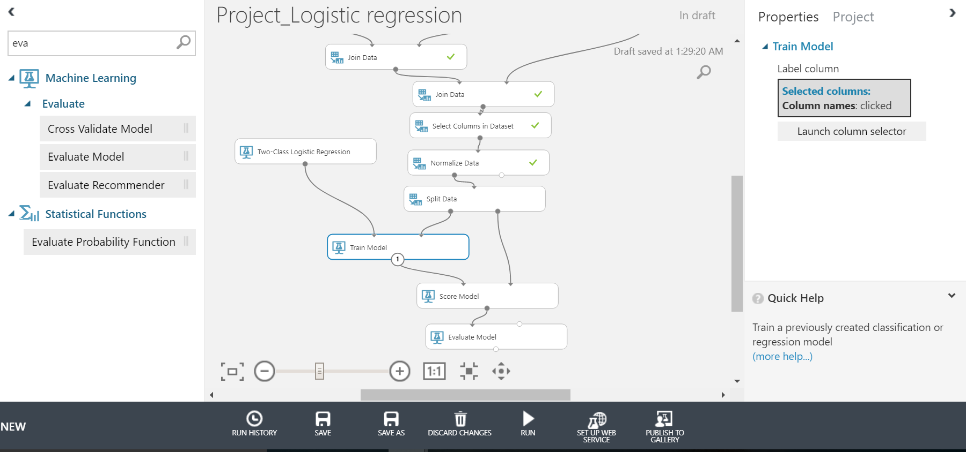
Logistic Regression

Slide 13
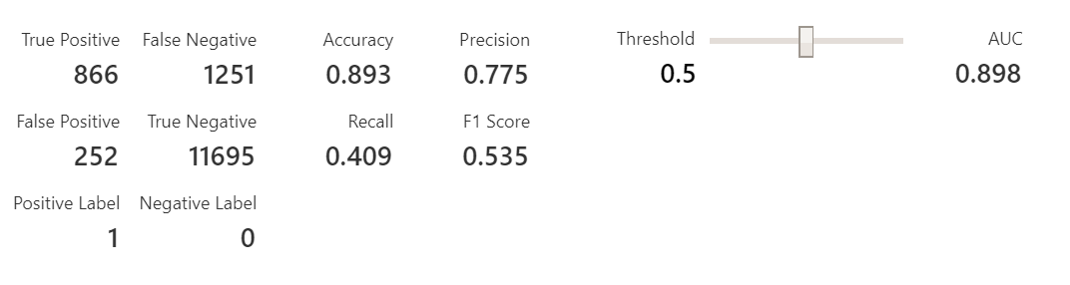
ACCURACY OF THE ALGORITHM
AUC OF ALGORITHM

Slide 14
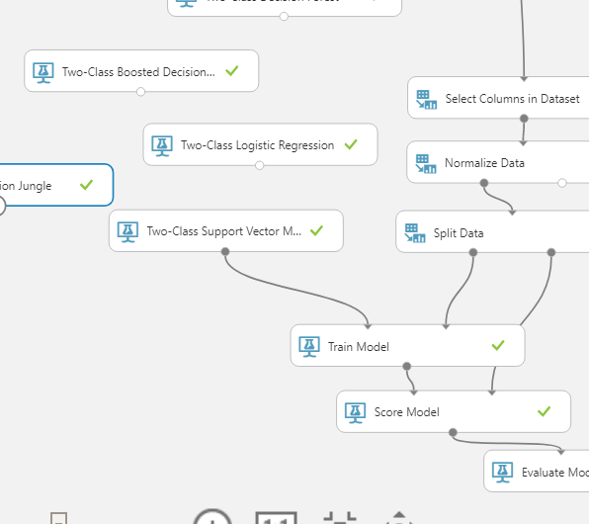
Support Vector Machine

Slide 15
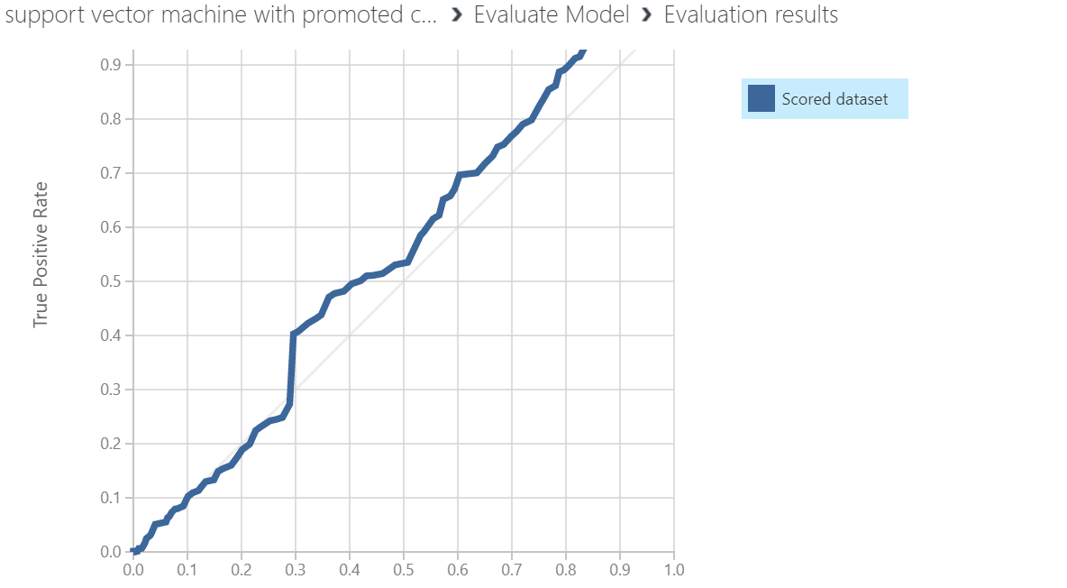
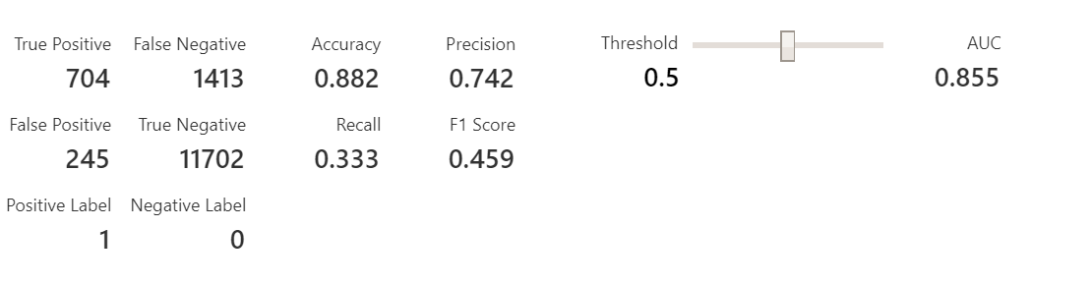
AUC OF ALGORITHM
ACCURACY OF ALGORITHM

Slide 16
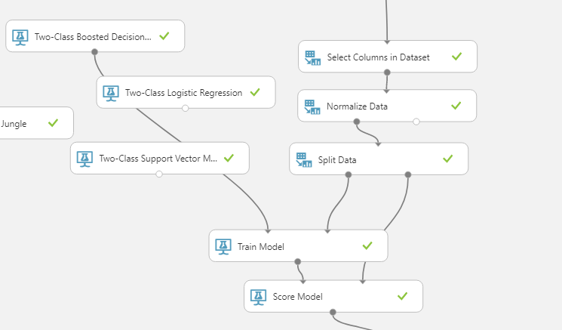
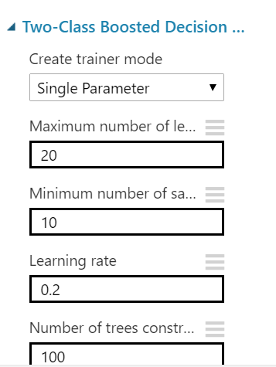
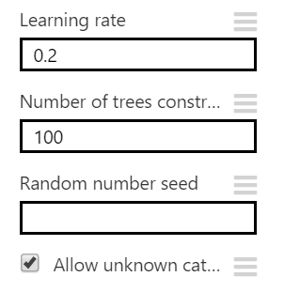
Two-Class Boosted Decision Tree

Slide 17
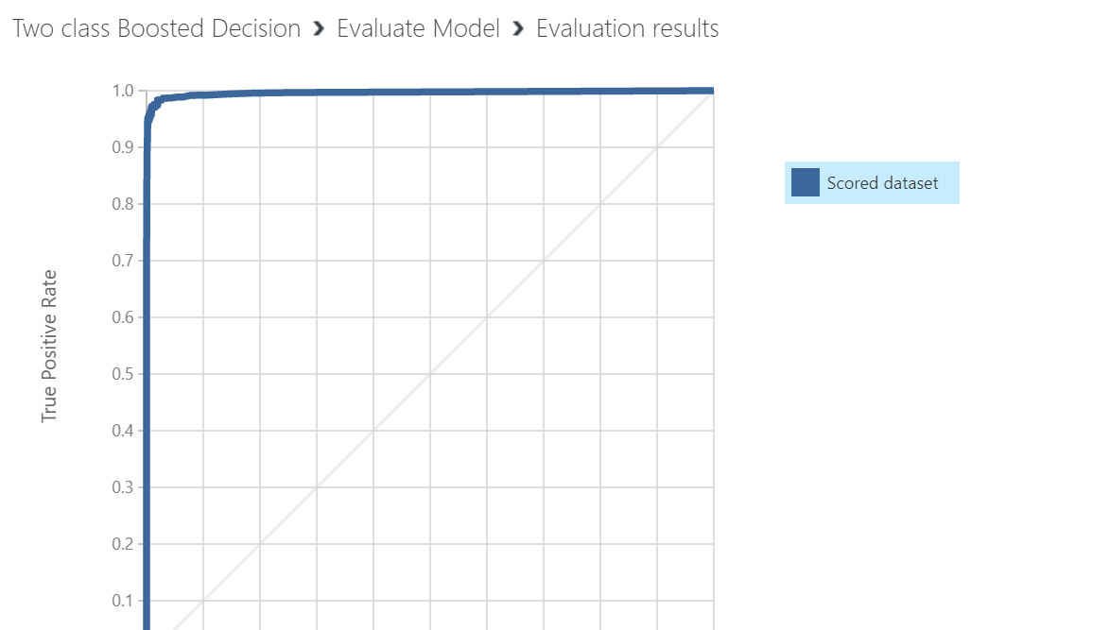
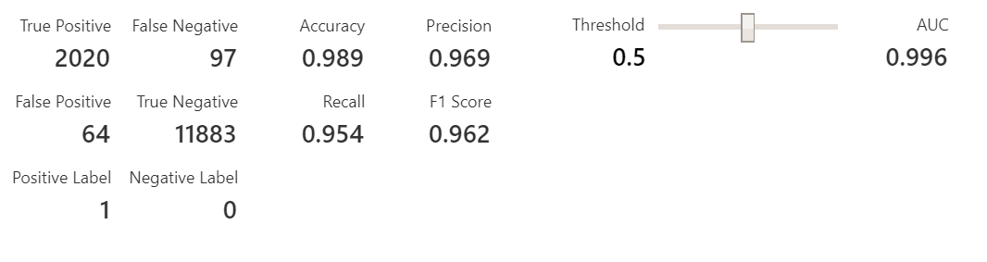
AUC OF ALGORITHM
ACCURACY OF ALGORITHM

Slide 18
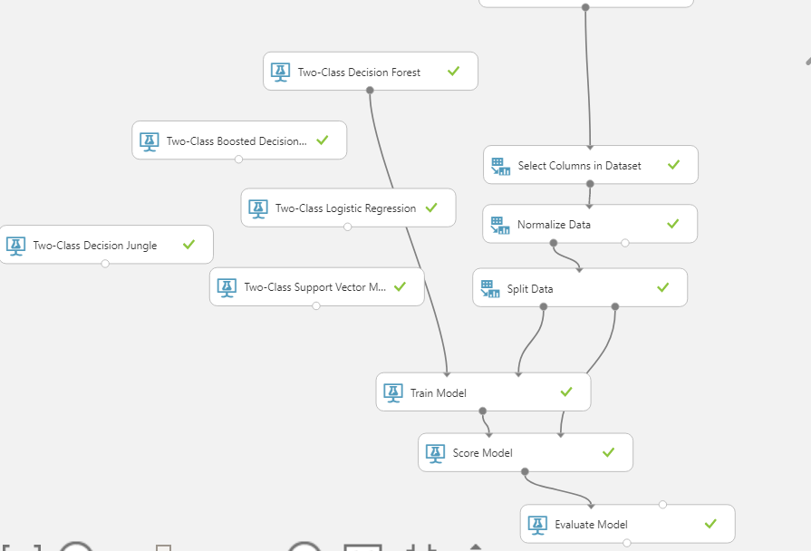
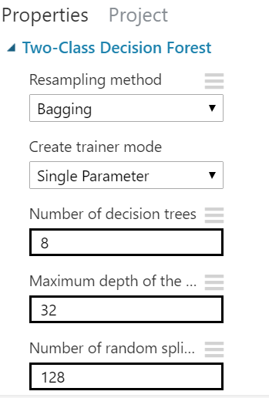
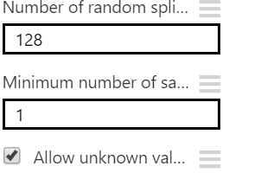
Two-Class Decision Forest

Slide 19
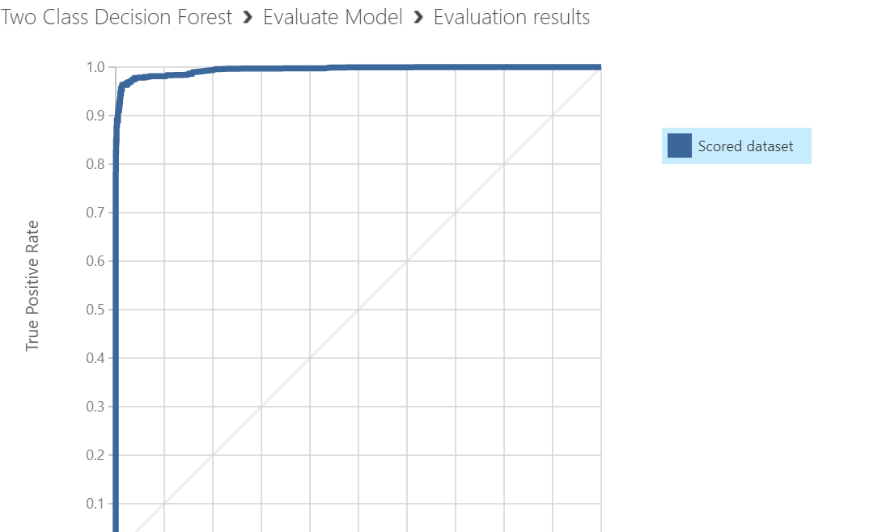
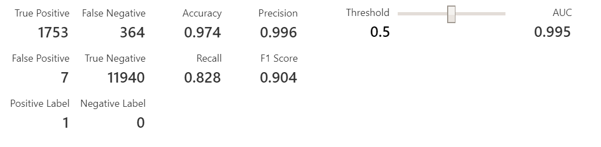
AUC OF ALGORITHM
ACCURACY OF ALGORITHM

Slide 20
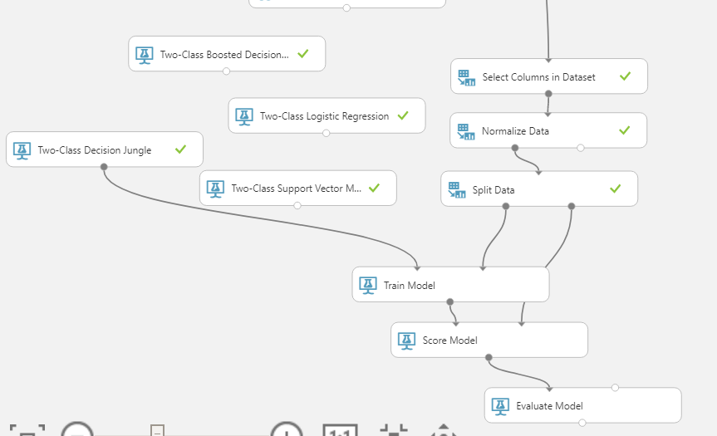
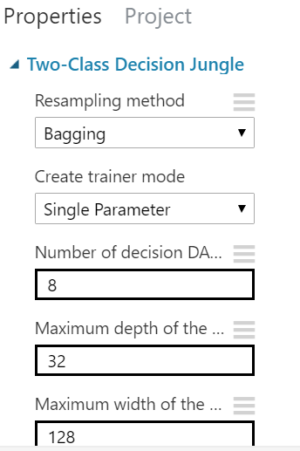
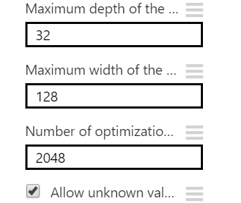
Two-Class Decision Jungle

Slide 21
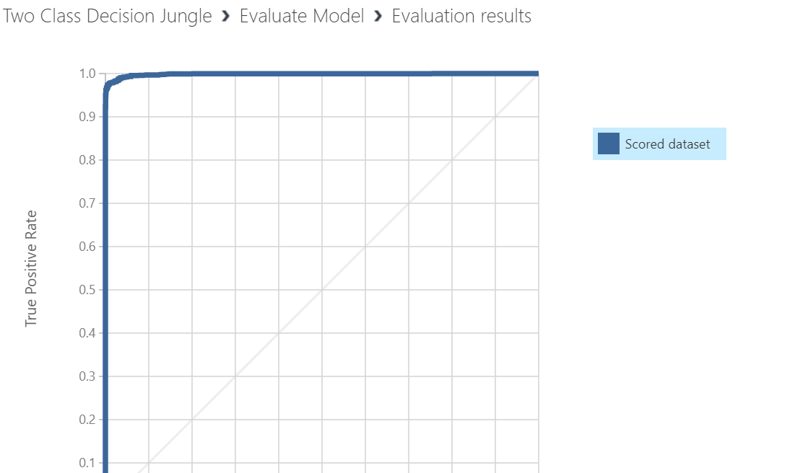
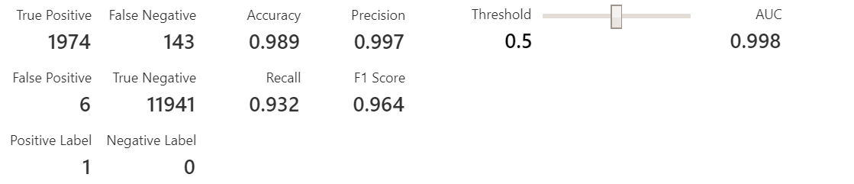
AUC OF ALGORITHM
ACCURACY OF ALGORITHM

Slide 22
Comparison of Azure ML Algorithms:
Azure ML | Accuracy | AUC
Logistic Regression | 0.893 | 0.898
Support Vector Machine | 0.882 | 0.855
Two-Class Boosted Decision Tree [ Gradient Boosted] | 0.989 | 0.996
Two-Class Decision Forest [ Random Forest] | 0.974 | 0.995
Two-Class Decision Jungle | 0.989 | 0.998

Slide 23
COMPARISON OF ALGORITHMS IN AZURE ML

Slide 24
Spark ML Databricks:
Original dataset: 5 GB
Sampled dataset of Spark ML : 105 MB

Slide 25
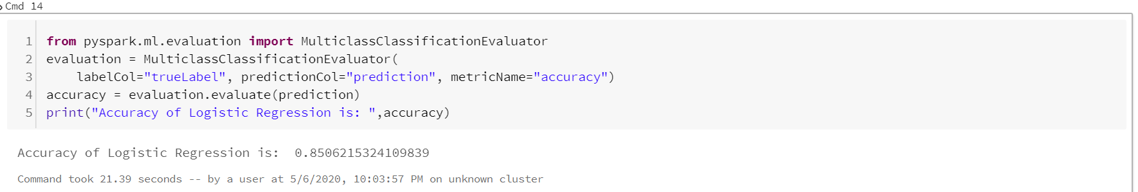
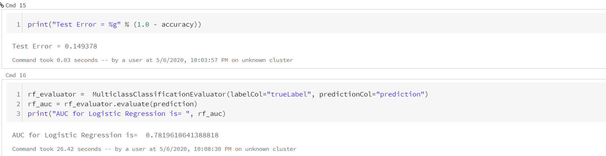
Logistic Regression

Slide 26
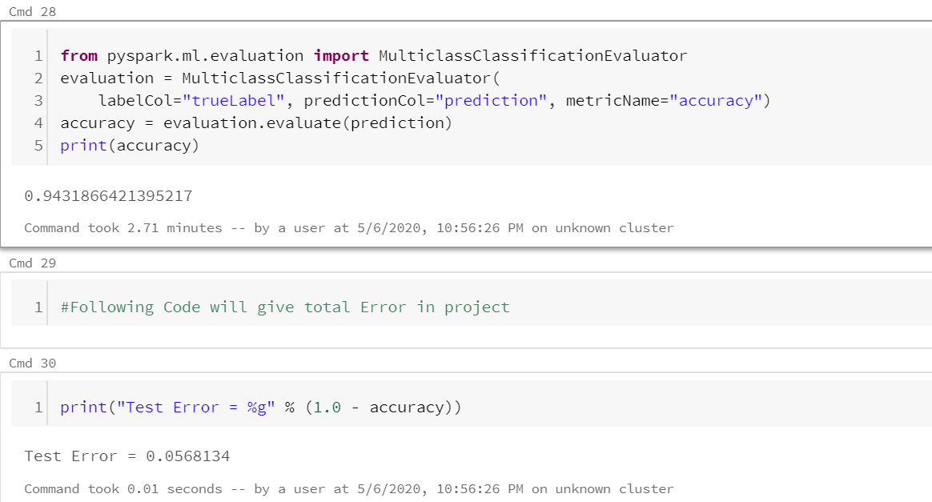
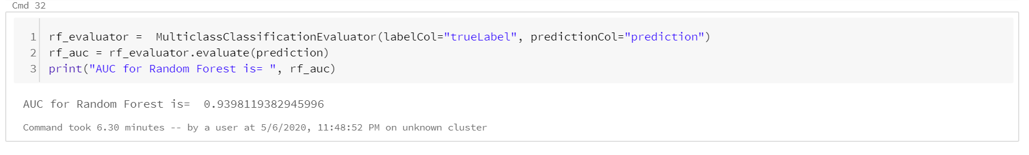
Random Forest

Slide 27
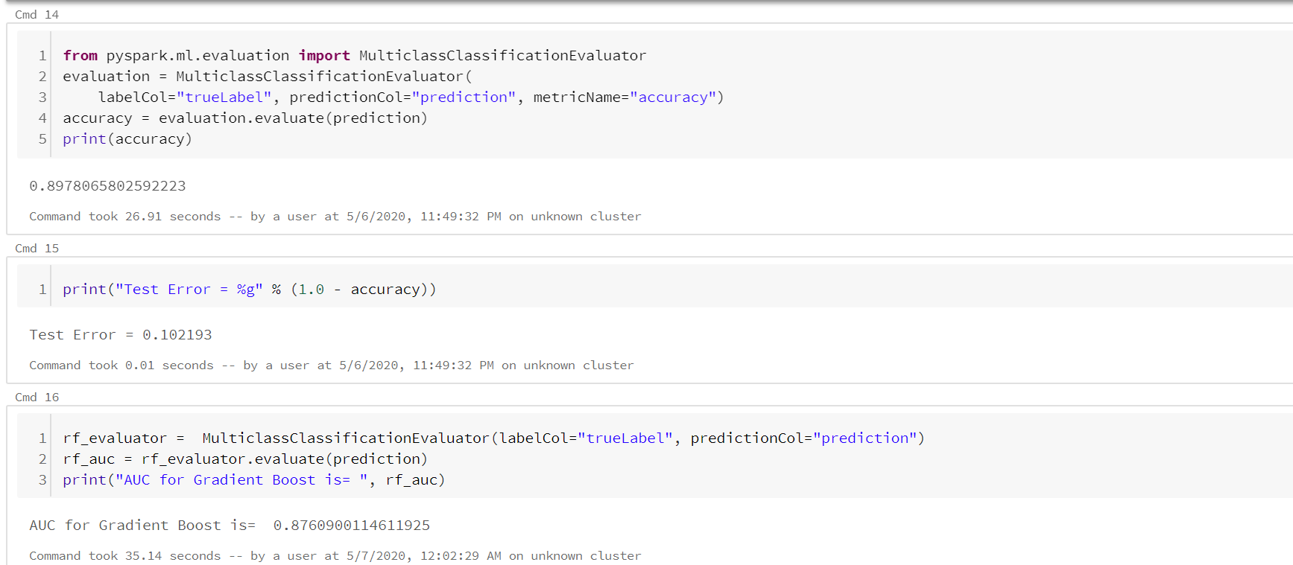
Gradient Boosting Algorithm

Slide 28
Prediction

Slide 29
Comparison Of Algorithm in Spark ML

Slide 30
Oracle BDCE

Slide 31
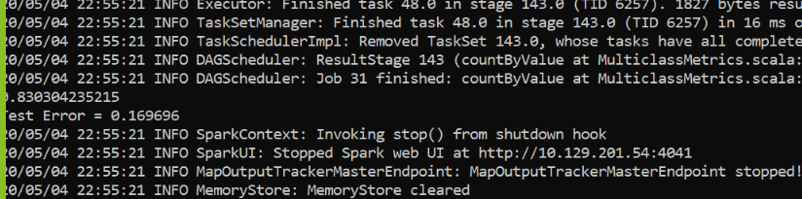
Logistic Regression
Accuracy For Logistic Regression Algorithm= 0.830304235215
for 1 GB Sampled Data
AUC For Logistic Regression =0.7539270092721175
Accuracy For Logistic Regression =0.830304235215
AUC For Logistic Regression Algorithm= 0.7539270092721175

Slide 32
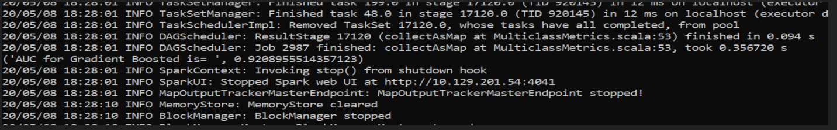
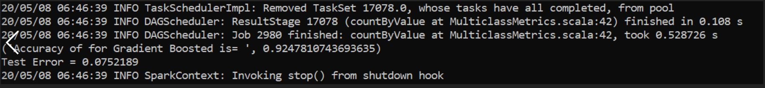
Gradient Boost Algorithm
AUC For Gradient Boost Algorithm= 0.9208955514357123
Accuracy For Gradient Boost Algorithm = 0.9247810743693635

Slide 33
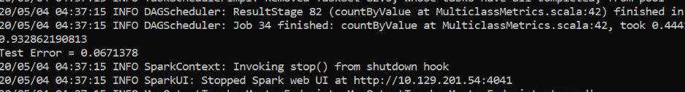
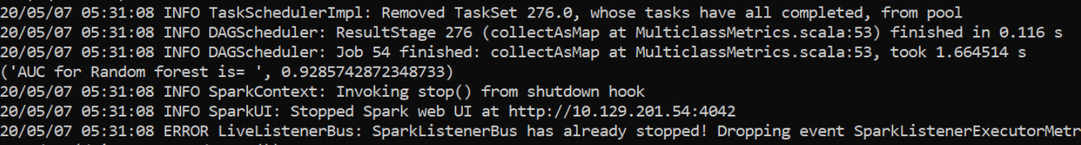
Random Forest Algorithm
Accuracy For Random Forest Algorithm for 100 MB = 0.932862190813
AUC For Random Forest Algorithm= 0.9285742872348733

Slide 34
Accuracy For Random Forest Algorithm for 1 GB

Slide 35
Comparison of Random Forest based on Size of data

Slide 36
Comparison of Oracle BDCE Algorithms:
Oracle BDCE | Accuracy | AUC
Logistic Regression | 0.830304235215 | 0.7539270092721175
Random Forest | 0.932862190813 | 0.9285742872348733
Gradient Boost Algorithm | 0.9208955514357 | 0.9247810743693635

Slide 37
CONCLUSION
Azure ML | Accuracy | AUC
Logistic Regression | 0.893 | 0.898
Support Vector Machine | 0.882 | 0.855
Two-Class Boosted Decision Tree | 0.989 | 0.996
Two-Class Decision Forest | 0.974 | 0.995
Two-Class Decision Jungle | 0.989 | 0.998
Spark ML | AAccuracy | AUCAUC
Logistic Regression | 0.850 | 0.781
Random Forest | 0.943 | 0.939
Gradient Boosted Algorithm | 0.897 | 0.876
Oracle BDCE | AAccuracy | AUAUC
Logistic Regression | 0.830 | 0.753
Random Forest | 0.932 | 0.928
Gradient Boosted Algorithm | 0.920 | 0.924

Slide 38

Summary
Prediction is very important as it helps us to predict which recommended content user will click which we found by using the algorithms.
Based on Accuracy and AUC , Gradient Boosted Algorithm and Random Forest Algorithm have better performance than Logistic Regression.

Slide 39
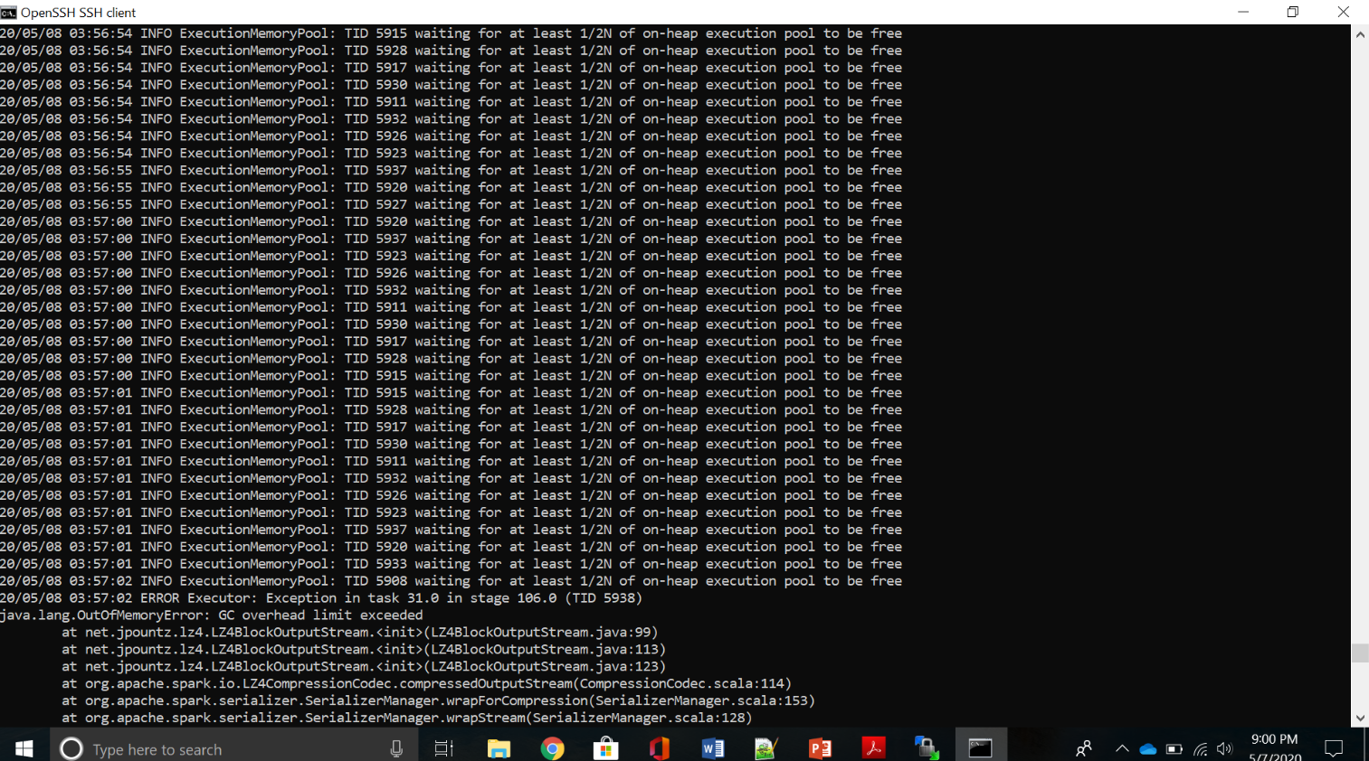
Challenges Faced
Oracle BDCE
1. Error : GC Overhead Exceed

Slide 40
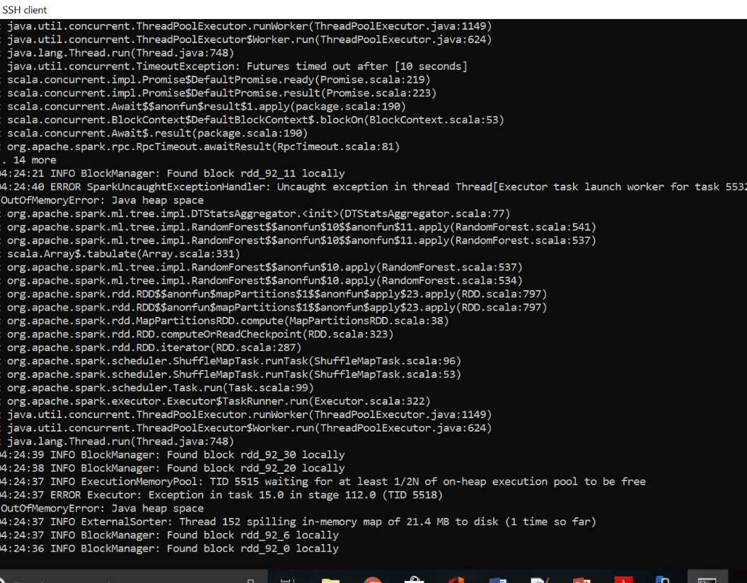
2. Error : Out Of Memory

Slide 41
Github Link
https://github.com/anjalibaldawa/Outbrain-Ad-Prediction

Slide 42
References
https://www.kaggle.com/c/outbrain-click-prediction/overview/description
https://www.semanticscholar.org/paper/Outbrain-Click-Prediction-Hoachuck-Singh/270046171591fe3bf17fbe2e3a59baa27ebf9bc9
https://medium.com/kaggle-blog/outbrain-click-prediction-competition-winners-interview-2nd-place-team-brain-afk-darragh-610d072fa3fc

Slide 43

Thankyou

